Slide 1
BUG DETECTION AND AUTO FIXING SYSTEM

Slide 2
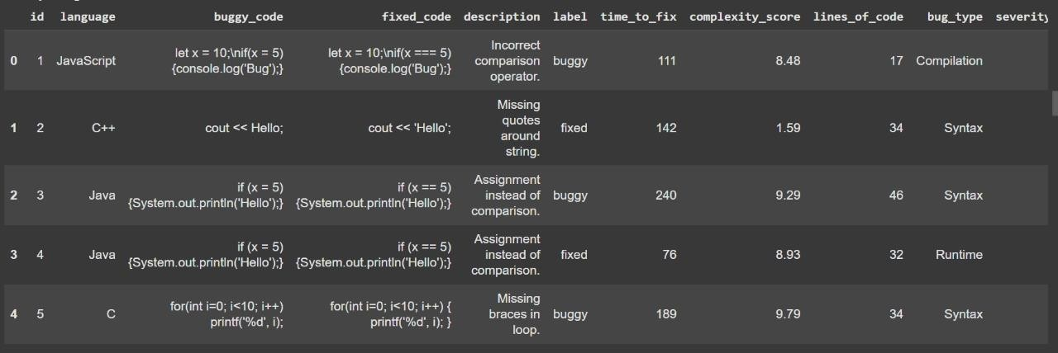
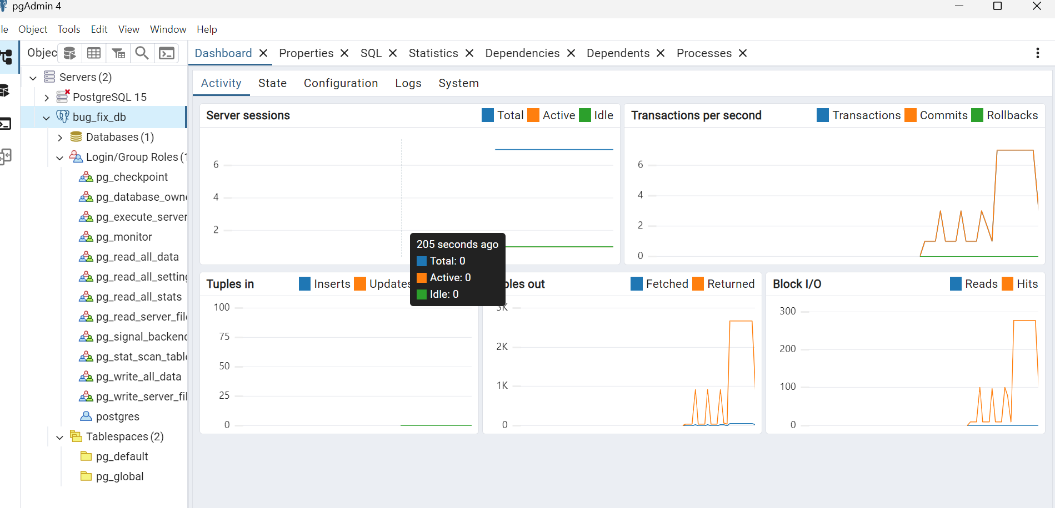
Functional Overview
Detection
Identifying the presence of bugs in the system.
Code reviews
Static analysis
Dynamic testing
Localization
Pinpointing the exact location of the bug.
Debugging tools
Log analysis
Code tracing

Slide 3
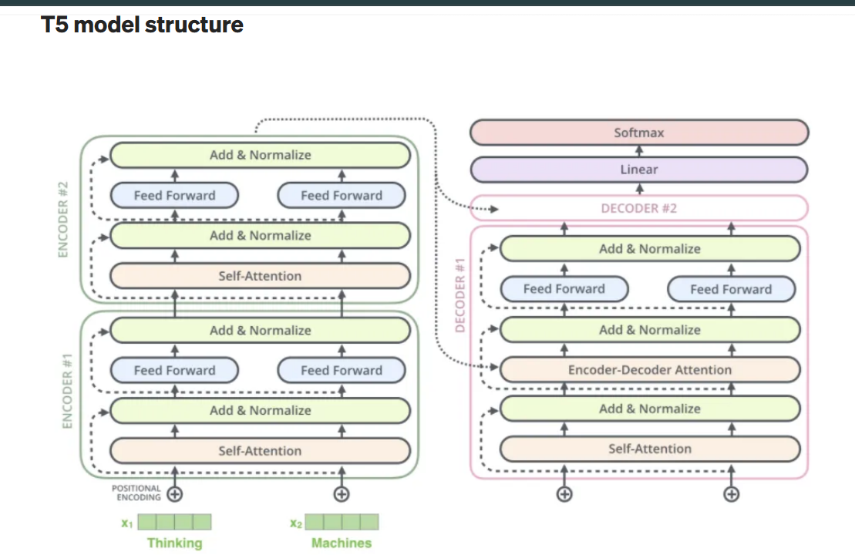
Workflow of the system
Input: Buggy code is given as a textual content enter inside the format "buggy: <code>".
Tokenization: The input is tokenized the use of T5’s tokenizer to transform it into version-readable layout.
Model Processing: The T5 model (encoder-decoder) is familiar with the buggy code and generates the fixed model.
Output: The model outputs the corrected code in the layout "constant: <corrected_code>".
Detokenization: The output is transformed again into readable supply code for developer use

Slide 4
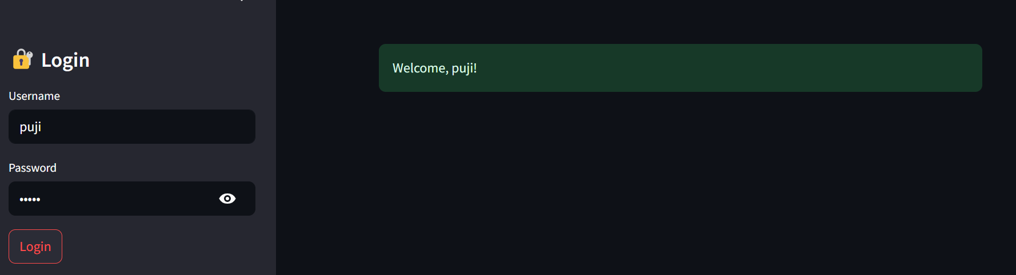
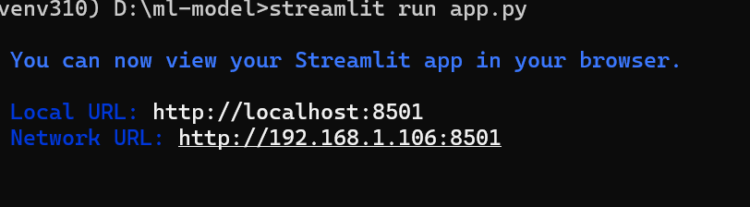
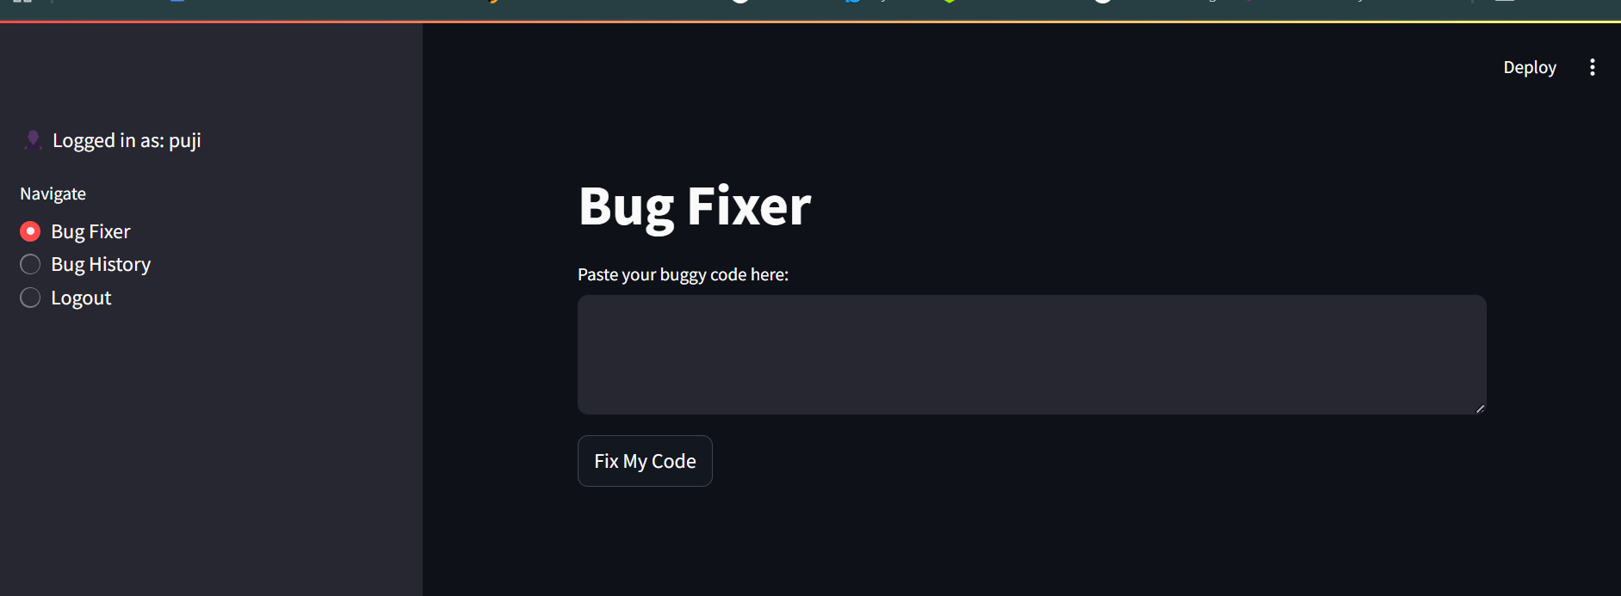
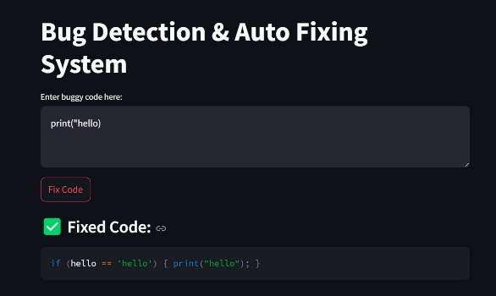
OUTPUT
After analysing the code it gives the result.
It fix the bugs in more languages and it improves accuracy.

Slide 5
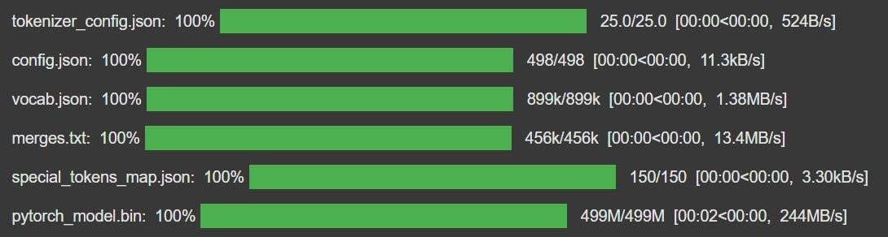
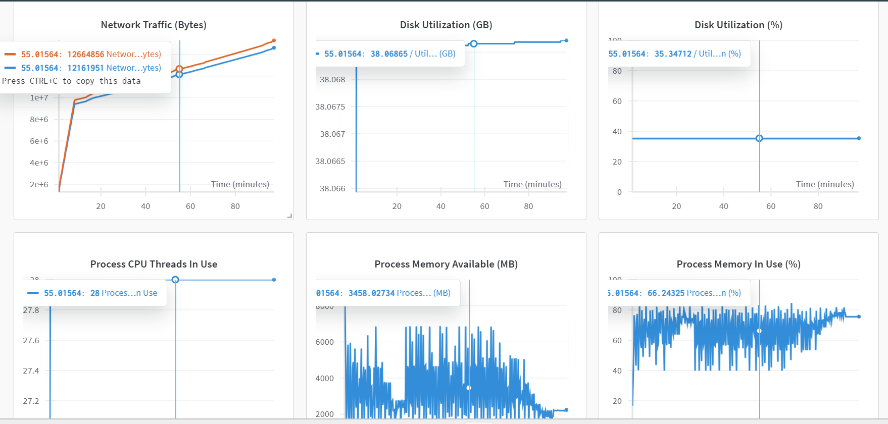
ANALYSIS OF THE SOLUTIONS
The T5 model gives an powerful solution for computerized worm detection and solving the usage of deep mastering. It complements code excellent, reduces debugging time, and helps scalable software improvement.

